Slide 1
Ada boosting Regressor
- P.Hameed Femina

Slide 2
Outline
Introduction
Functionality
Algorithm
Performance and Application

Slide 3
What is Ada boosting Regressor
An AdaBoost regressor is a meta-estimator that begins by fitting a regressor on the original dataset and then fits additional copies of the regressor on the same dataset but where the weights of instances are adjusted according to the error of the current prediction.
Note: Meta estimator: estimator(Model) which takes another estimator as input is called meta estimator

Slide 4
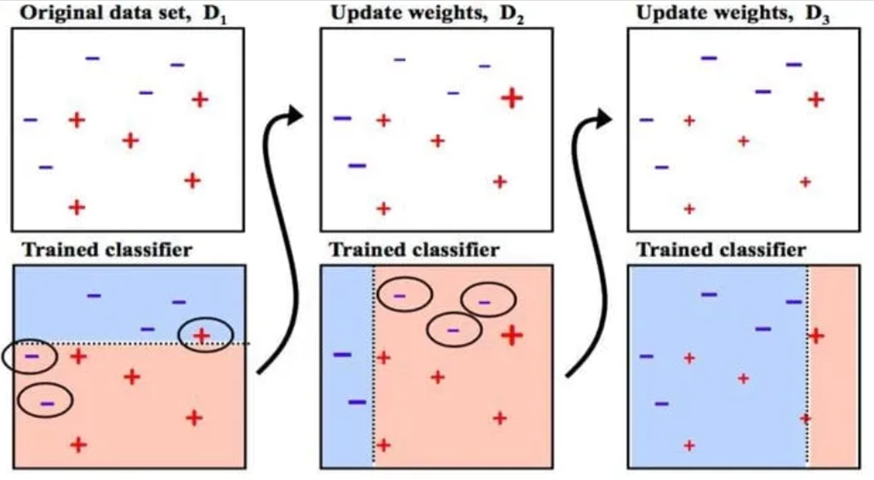

Slide 5
Random forest vs Ada Boosting
Random forest improve Decision tree parallelly but this Ada boosting does sequentially
RF low density tree but Ada boosting use Decision stumps
FR –Low bias low variance but Ada boosting – high bias low variance
RF same weight to assigned to all tree to improve it in ada boosting according to the model accuracy weight is added

Slide 6
Advantage and Disadvantage
Advantage:
easy to use not much hyper parameters
Increased accuracy
Immunity from overfitting.
Disavantage:
It need quality of data . Noise can create impact in result.

Slide 7
Algorithm - syntax
From sklearn.ensemble import AdaBoostRegressor()
Reg = AdaBoostRegressor()

Slide 8
Thankyou

